Slide 1
RECOMMENDATION SYSTEM
BY:
KARANDEEP(2003402)
SHAREKSH(2003415)
VIPUL VERMA (2003420)

Slide 2
INTRODUCTION
RECOMMENDATION SYSTEM INVOLVE PREDICTING USERS PREFERANCES FOR UNSEEN ITEMS
RECOMMENDATION SYSTEM (RS) WILL RECOMMEND USERS WITH MOVIES
IT WILL GOING TO BE AN WEB APPLICATION WHICH WILL HAVE MOVIES SECTION

Slide 3
OBJECTIVE
BY USING RECOMMENDATIONS WE CAN TAKE A SHORTCUT TO THE THINGS WE LIKE WITHOUT HAVING TO TRY MANY THINGS WE DISLIKE OR WITHOUT HAVING TO ACQUIRE ALL THE KNOWLADGE TO MAKE A INFORMED SEARCH
IT WILL BASICALLY HELPS USER TO GO THROUGH THE DESIRED CONTENT INSTEAD OF STRUGGLING WITH EXTRA UNDESIRED HEAP OF CONTENT

Slide 4
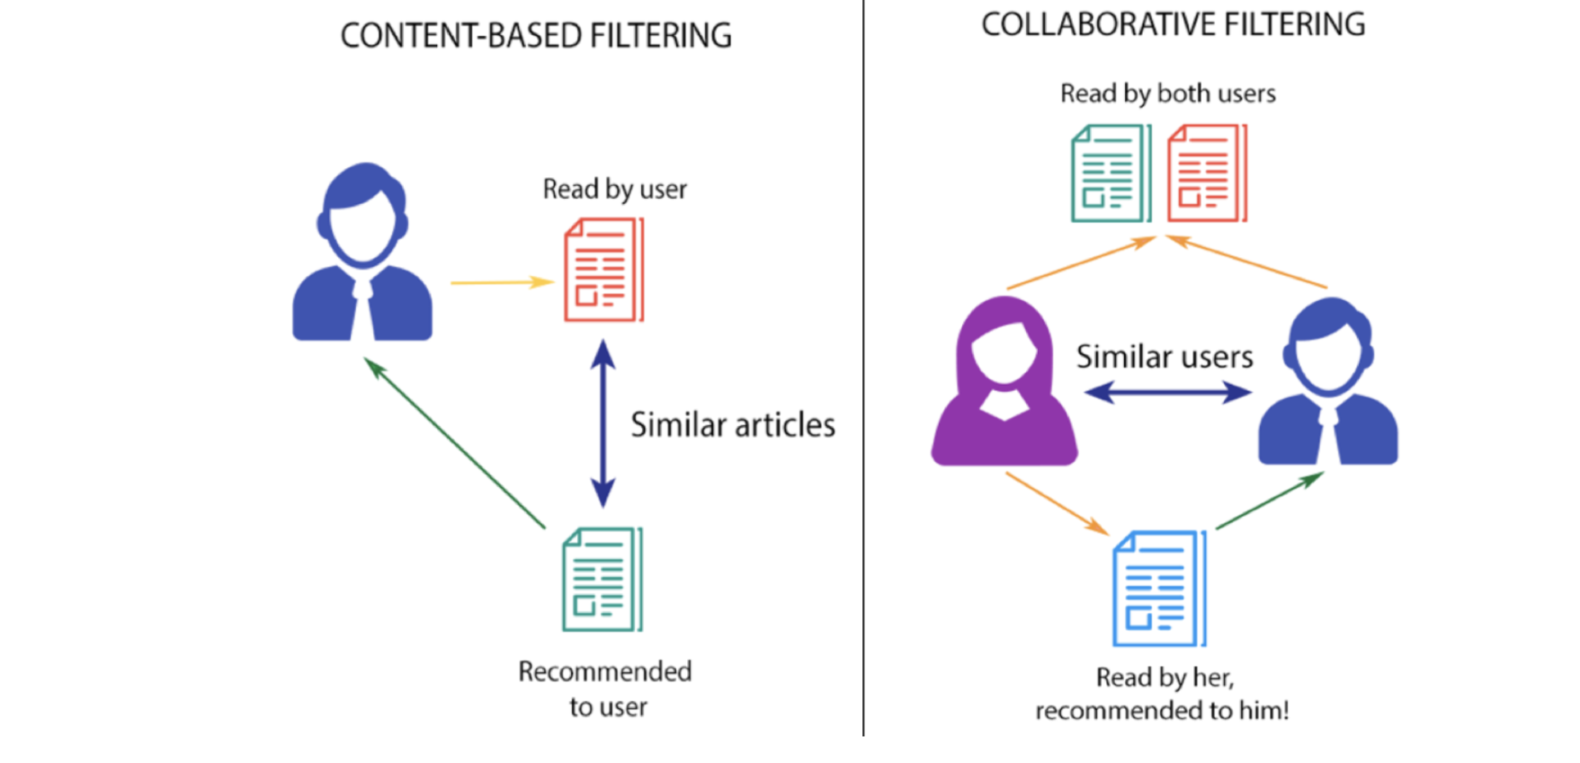
APPROACH

Slide 5
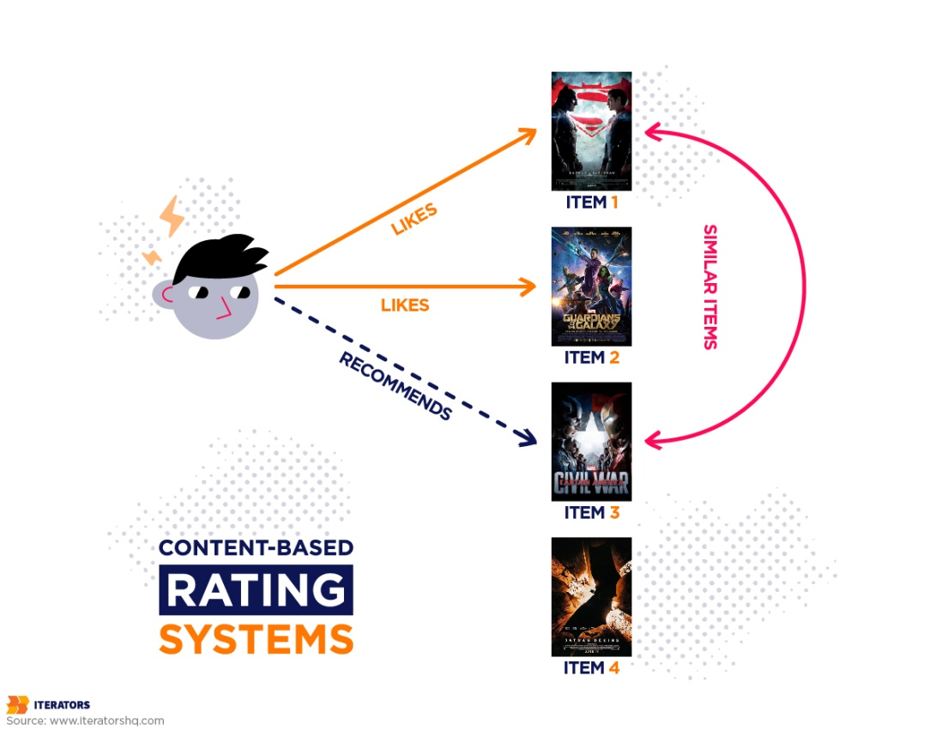
WORKING

Slide 6
TECHNOLOGY USED
MACHINE LEARNING: 1.VECTORIZATION
2.COSINE SIMILARITY
STREAMLIT: USED FOR CREATING WEB APPLICATION
FROM ML MODEL
PYTHON LIBRARY: 1.PANDAS
2. NUMPY
3.MATPLOTLIB
4. SEABORN

Slide 7
VECTORIZATION
BAG OF WORDS IS AN TECHNIQUE WHICH IS USED TO REPRESENT TEXT INTO VECTORS
IN THESE WE BASICALLY MAPS THE WORDS OF THE TAGS OF EACH MOVIE WITH EACH OTHER AND PLOT THEM IN N DIMENSIONAL SPACE
IN THESE RECOMMENDATION SYSTEM WE USED 5000 WORDS AND MAP THOSE WORDS WITH THEIR OCCURANCE IN THE TAGS OF 5000 MOVIES
AFTER MAPPING THEM WE PLOT THEM IN N DIMMENSIONAL SPACE

Slide 8
COSINE SIMILARITY
COSINE SIMILARITY MEASURES THE SIMILARITY BETWEEN TWO VECTORS PLOTTED IN THE SPACE
IT IS MEASURED BY THE COSINE OF THE ANGLE BETWEEN TWO VECTORS

Slide 9

DATASET AND API
TMDB 5000 MOVIE DATASET FROM KAGGLE
THEMOVIESDB.ORG API FOR FETCHING POSTERS AND DATA

Slide 10
FUTURE SCOPE
APPENDING THE DATABASE TO THE LATEST
WEB SERIES AND REGIONAL MOVIES
RATING AND REVIEW SYSTEM
OPTIMIZING THE MODEL WITH BETTER ALGORITHMS

Slide 11
THANK YOU!

Slide 12
ANY QUERY?

